Slide 1
Chapter 15 - C++ As A
"Better C"
Outline
15.1 Introduction
15.2 C++
15.3 A Simple Program: Adding Two Integers
15.4 C++ Standard Library
15.5 Header Files
15.6 Inline Functions
15.7 References and Reference Parameters
15.8 Default Arguments and Empty Parameter Lists
15.9 Unary Scope Resolution Operator
15.10 Function Overloading
15.11 Function Templates

Slide 2
Objectives
In this chapter, you will learn:
  To become familiar with the C++ enhancements to C.
  To become familiar with the C++ standard library.
  To understand the concept of inline functions.
  To be able to create and manipulate references.
  To understand the concept of default arguments.
  To understand the role the unary scope resolution operator has in scoping.
  To be able to overload functions.
  To be able to define functions that can perform similar operations on different types of data.

Slide 3
15.1 Introduction
First 14 Chapters
  Procedural programming
  Top-down program design with C
Chapters 15 to 23
  C++ portion of book
  Object based programming (classes, objects, encapsulation)
  Object oriented programming (inheritance, polymorphism)
  Generic programming (class and function templates)

Slide 4
15.2 C++
C++
  Improves on many of C's features
  Has object-oriented capabilities
    Increases software quality and reusability
  Developed by Bjarne Stroustrup at Bell Labs
    Called "C with classes"
    C++ (increment operator) - enhanced version of C
  Superset of C
    Can use a C++ compiler to compile C programs
    Gradually evolve the C programs to C++
ANSI C++
  Final version at http://www.ansi.org/
  Free, older version at http://www.cygnus.com/misc/wp/

Slide 5
15.3 A Simple Program: Adding Two Integers
File extensions
  C files: .c
  C++ files: .cpp (which we use), .cxx, .C (uppercase)
Differences
  C++ allows you to "comment out" a line by preceding it with //
  For example: // text to ignore
  <iostream> - input/output stream header file
  Return types - all functions must declare their return type
    C does not require it, but C++ does
  Variables in C++ can be defined almost anywhere
    In C, required to defined variables in a block, before any executable statements

Slide 6
15.3 A Simple Program: Adding Two Integers (II)
Input/Output in C++
  Performed with streams of characters
  Streams sent to input/output objects
Output
  std::cout - standard output stream (connected to screen)
  << stream insertion operator ("put to")
  std::cout << "hi";
    Puts "hi" to std::cout, which prints it on the screen
Input
  std::cin - standard input object (connected to keyboard)
  >> stream extraction operator ("get from")
  std::cin >> myVariable;
    Gets stream from keyboard and puts it into myVariable

Slide 7
15.3 A Simple Program: Adding Two Integers (III)
std::endl
  "end line"
  Stream manipulator - prints a newline and flushes output buffer
    Some systems do not display output until "there is enough text to be worthwhile"
    std::endl forces text to be displayed
using statements
  Allow us to remove the std:: prefix
  Discussed later
Cascading
  Can have multiple << or >> operators in a single statement
  std::cout << "Hello " << "there" << std::endl;

Slide 8
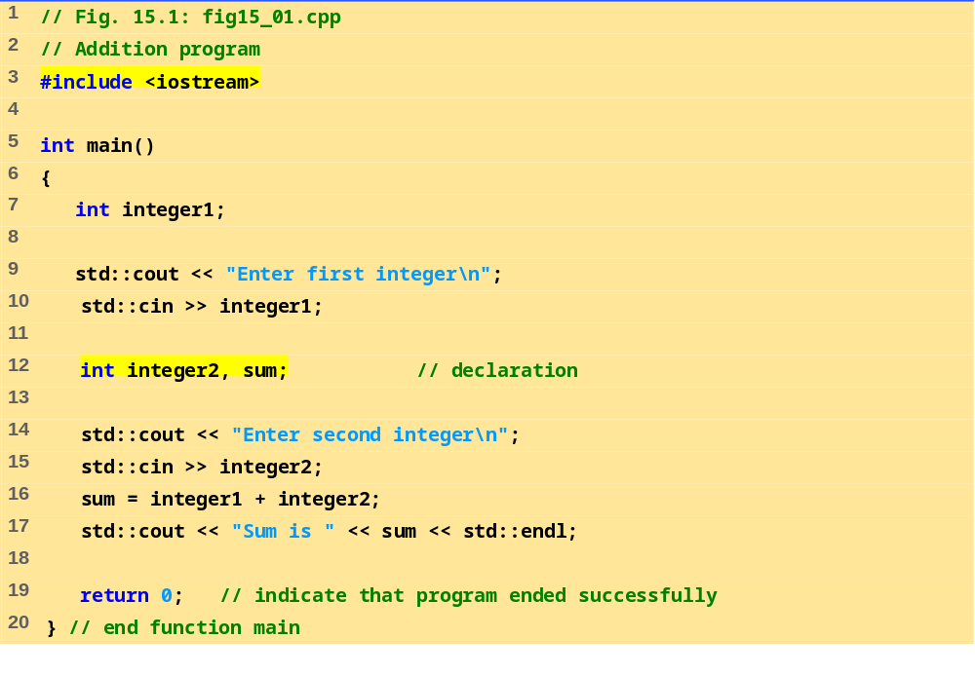
fig15_01.cpp
Enter first integer
45
Enter second integer
72
Sum is 117

Slide 9
15.4 C++ Standard Library
C++ programs built from
  Functions
  Classes
    Most programmers use library functions
Two parts to learning C++
  Learn the language itself
  Learn the library functions
Making your own functions
  Advantage: you know exactly how they work
  Disadvantage: time consuming, difficult to maintain efficiency and design well

Slide 10
15.5 Header Files
Header files
  Each standard library has header files
    Contain function prototypes, data type definitions, and constants
  Files ending with .h are "old-style" headers
User defined header files
  Create your own header file
    End it with .h
  Use #include "myFile.h" in other files to load your header

Slide 11
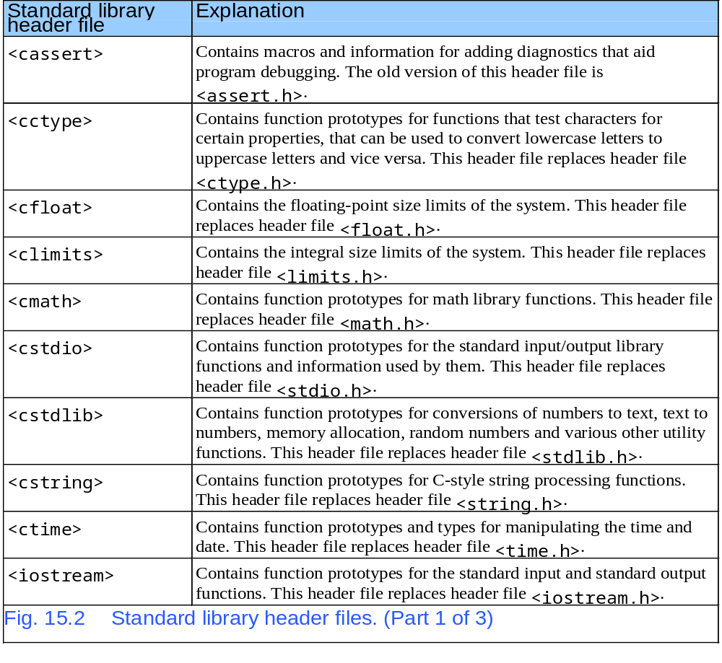
15.5 Header Files

Slide 12
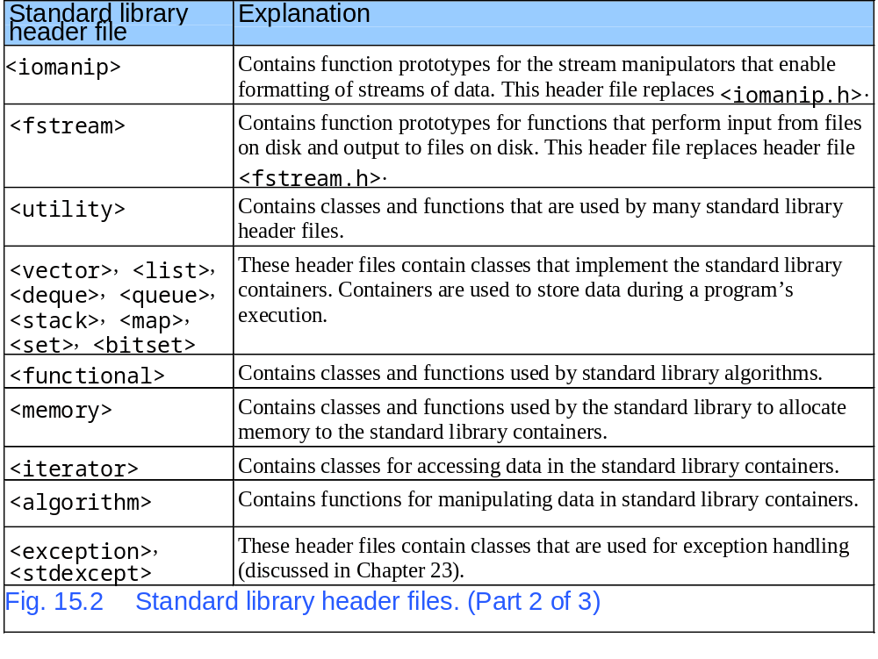
15.5 Header Files

Slide 13
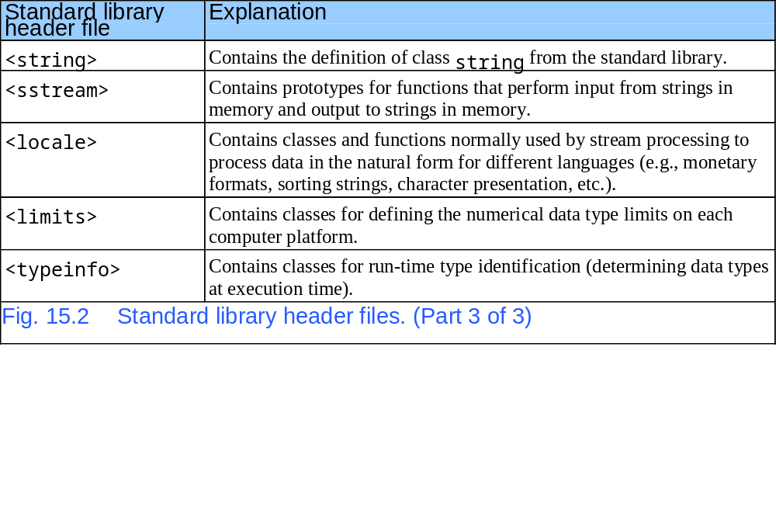
15.5 Header Files

Slide 14
15.6 Inline Functions
Function calls
  Cause execution-time overhead
  Qualifier inline before function return type "advises" a function to be inlined
    Puts copy of function's code in place of function call
  Speeds up performance but increases file size
  Compiler can ignore the inline qualifier
    Ignores all but the smallest functions
  inline double cube( const double s )
  { return s * s * s; }
Using statements
  By writing using std::cout; we can write cout instead of std::cout in the program
  Same applies for std::cin and std::endl

Slide 15
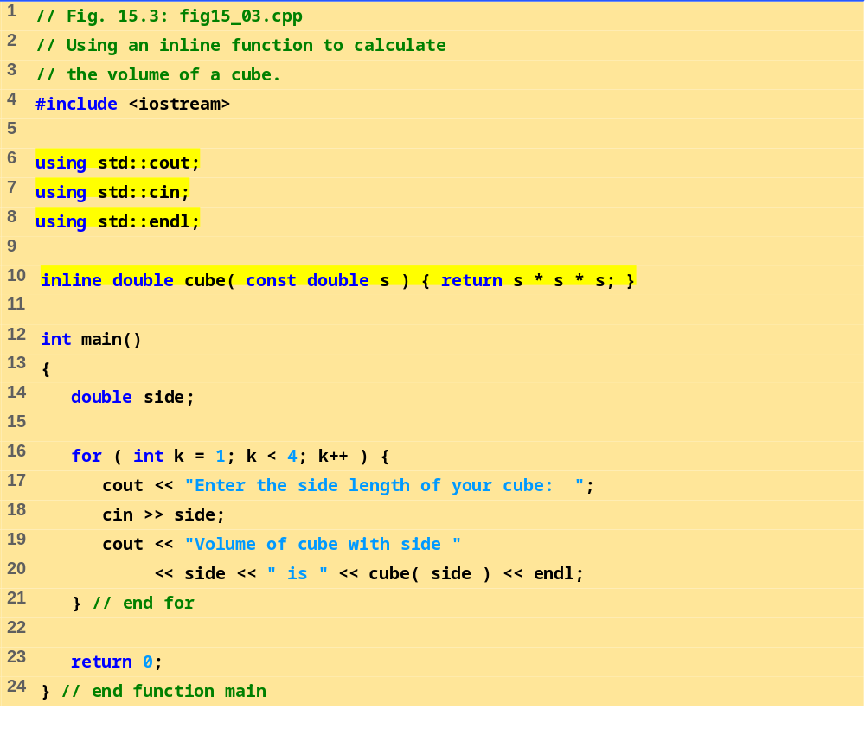
fig15_03.cpp

Slide 16
Program Output
Enter the side length of your cube: 1.0
Volume of cube with side 1 is 1
Enter the side length of your cube: 2.3
Volume of cube with side 2.3 is 12.167
Enter the side length of your cube: 5.4
Volume of cube with side 5.4 is 157.464

Slide 17
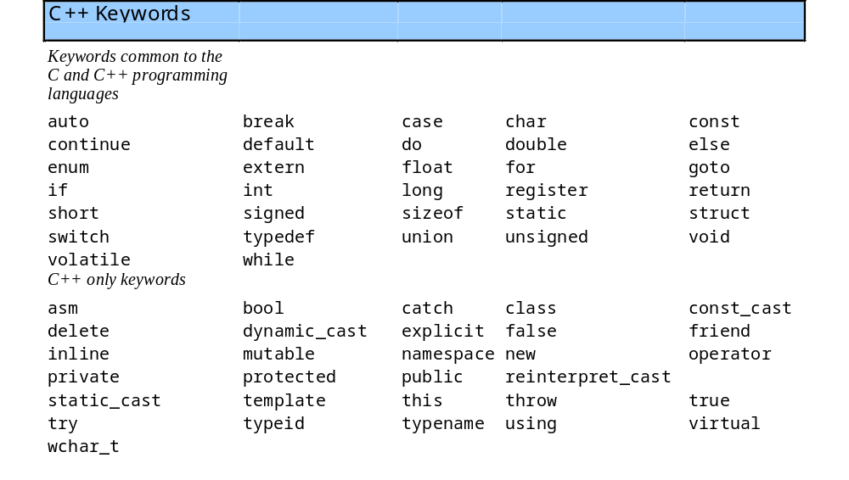
15.6 Inline Functions (II)
bool
  Boolean - new data type, can either be true or false

Slide 18
15.7 References and Reference Parameters
Call by value
  Copy of data passed to function
  Changes to copy do not change original
Call by reference
  Function can directly access data
  Changes affect original
Reference parameter alias for argument
  Use &
    void change(int &variable)
    {
    variable += 3;
    }
    Adds 3 to the original variable input
  int y = &x
    Changing y changes x as well

Slide 19
15.7 References and Reference Parameters (II)
Dangling references
  Make sure to assign references to variables
  If a function returns a reference to a variable, make sure the variable is static
    Otherwise, it is automatic and destroyed after function ends
Multiple references
  Like pointers, each reference needs an &
  int &a, &b, &c;

Slide 20
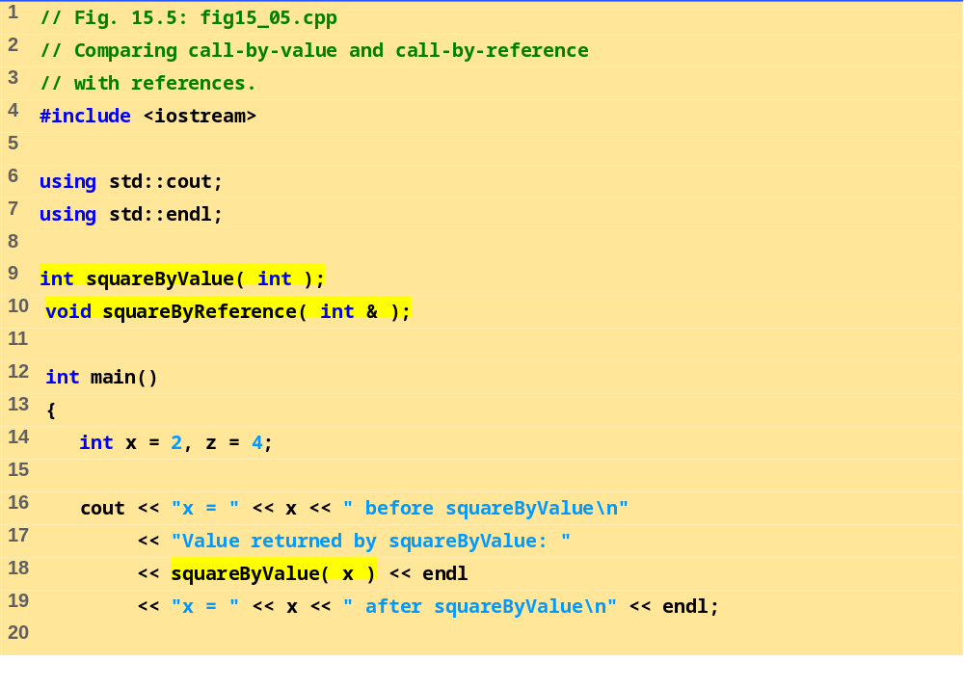
fig15_05.cpp (Part 1 of 2)

Slide 21
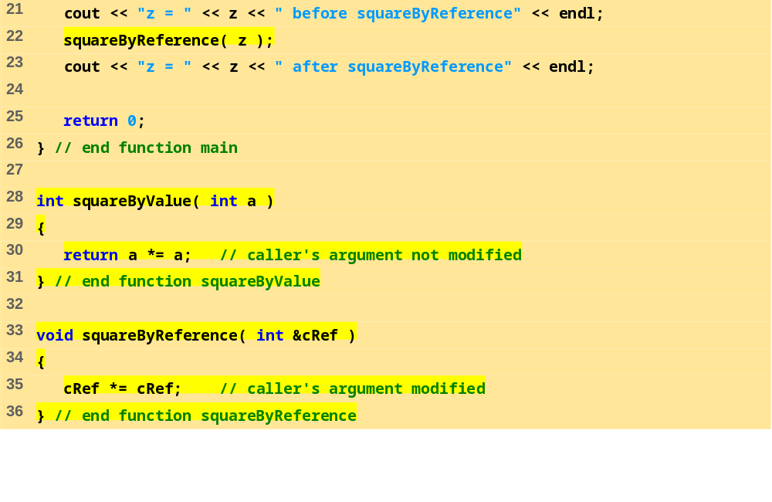
fig15_05.cpp (Part 2 of 2)
Program Output
x = 2 before squareByValue
Value returned by squareByValue: 4
x = 2 after squareByValue
z = 4 before squareByReference
z = 16 after squareByReference

Slide 22
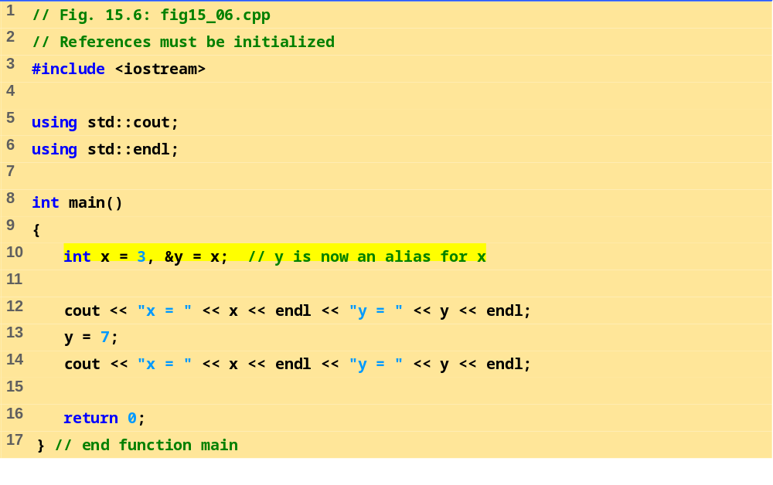
fig15_06.cpp
x = 3
y = 3
x = 7
y = 7

Slide 23
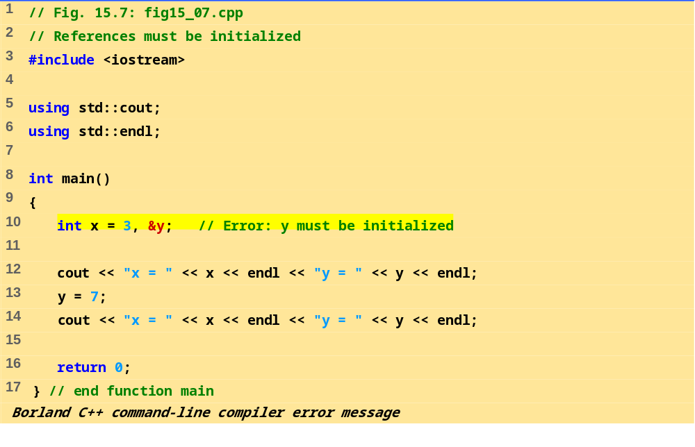
fig15_.07.cpp
Error E2304 Fig15_07.cpp 10: Reference variable 'y' must be initialized in function main()
Microsoft Visual C++ compiler error message
Fig15_07.cpp(10) : error C2530: 'y' : references must be initialized

Slide 24
15.8 Default Arguments and Empty Parameter Lists
If function parameter omitted, gets default value
  Can be constants, global variables, or function calls
  If not enough parameters specified, rightmost go to their defaults
Set defaults in function prototype
  int myFunction( int x = 1, int y = 2, int z = 3 );

Slide 25
15.8 Default Arguments and Empty Parameter Lists (II)
Empty parameter lists
  In C, empty parameter list means function takes any argument
    In C++ it means function takes no arguments
  To declare that a function takes no parameters:
    Write void or nothing in parentheses
    Prototypes:
  void print1( void );
  void print2();

Slide 26
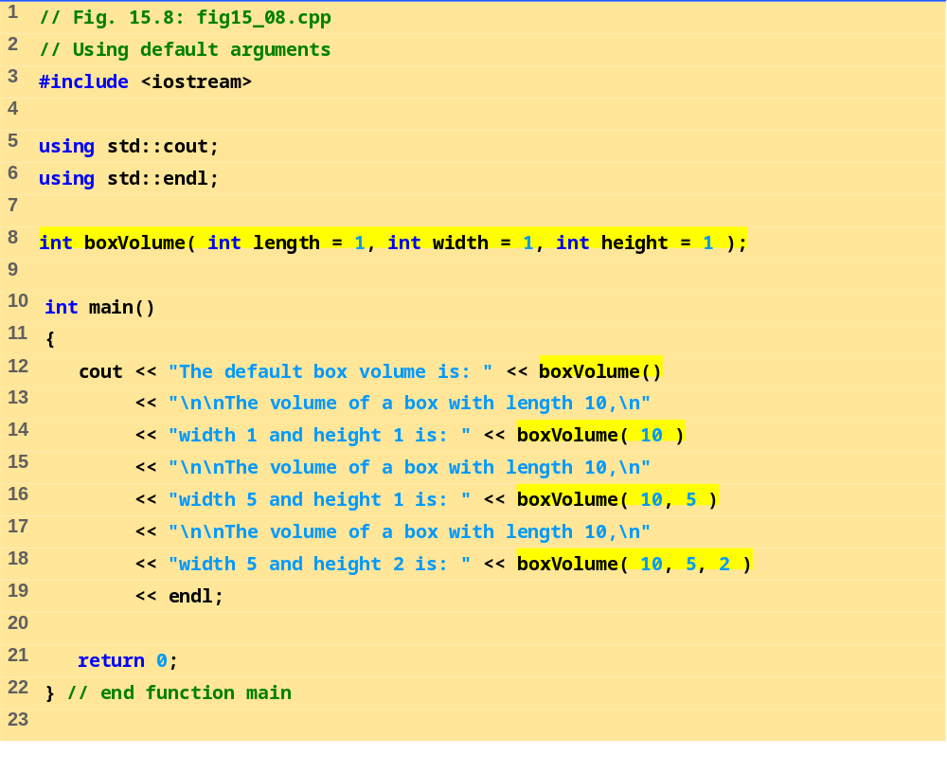
fig15_08.cpp (Part 1 of 2)

Slide 27
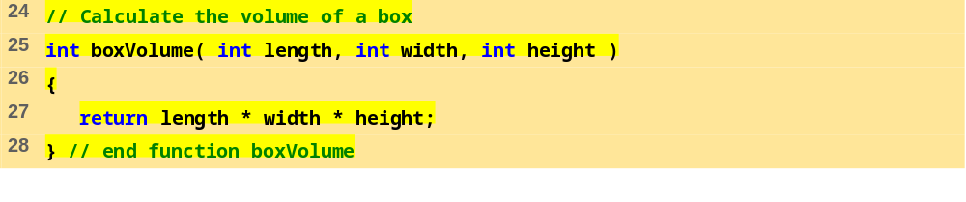
fig15_08.cpp (Part 2 of 2)
The default box volume is: 1
The volume of a box with length 10,
width 1 and height 1 is: 10
The volume of a box with length 10,
width 5 and height 1 is: 50
The volume of a box with length 10,
width 5 and height 2 is: 100

Slide 28
15.9 Unary Scope Resolution Operator
Unary scope resolution operator (::)
  Access global variables if a local variable has same name
  Instead of variable use ::variable
static_cast<newType> (variable)
  Creates a copy of variable of type newType
  Convert ints to floats, etc.
Stream manipulators
  Can change how output is formatted
  setprecision - set precision for floats (default 6 digits)
  setiosflags - formats output
  setwidth - set field width
  Discussed in depth in Chapter 21

Slide 29
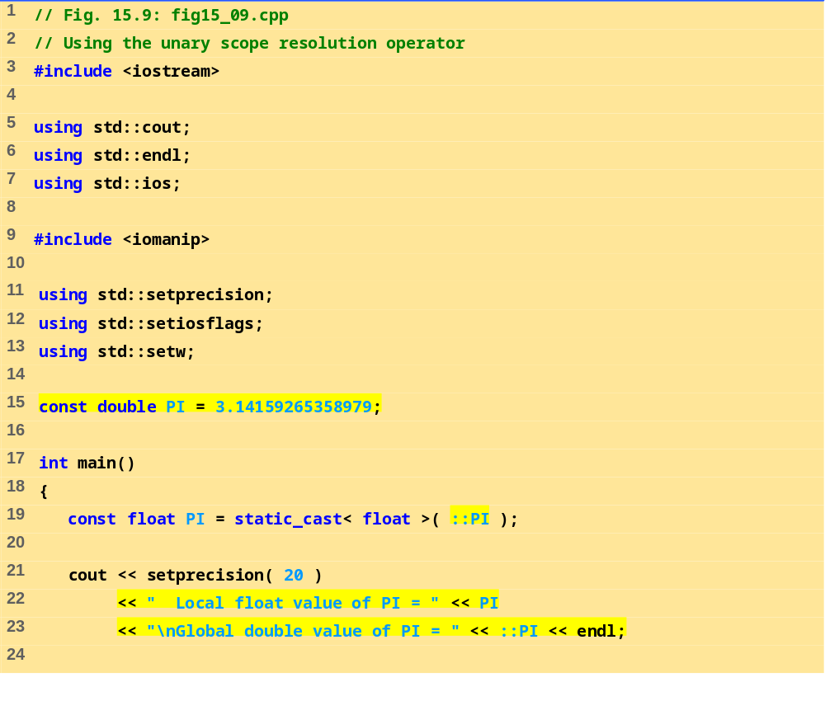
fig15_09.cpp (Part 1 of 2)

Slide 30
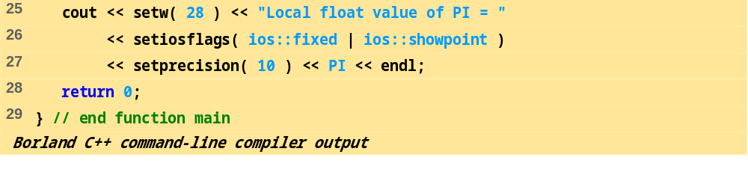
fig15_09.cpp (Part 2 of 2)
Local float value of PI = 3.141592741012573242
Global double value of PI = 3.141592653589790007
Local float value of PI = 3.1415927410
Microsoft Visual C++ compiler output
Local float value of PI = 3.1415927410125732
Global double value of PI = 3.14159265358979
Local float value of PI = 3.1415927410

Slide 31
15.10 Function Overloading
Function overloading:
  Functions with same name and different parameters
  Overloaded functions should perform similar tasks
    Function to square ints and function to square floats
  int square( int x) {return x * x;}
  float square(float x) { return x * x; }
  Program chooses function by signature
    Signature determined by function name and parameter types
    Type safe linkage - ensures proper overloaded function called

Slide 32
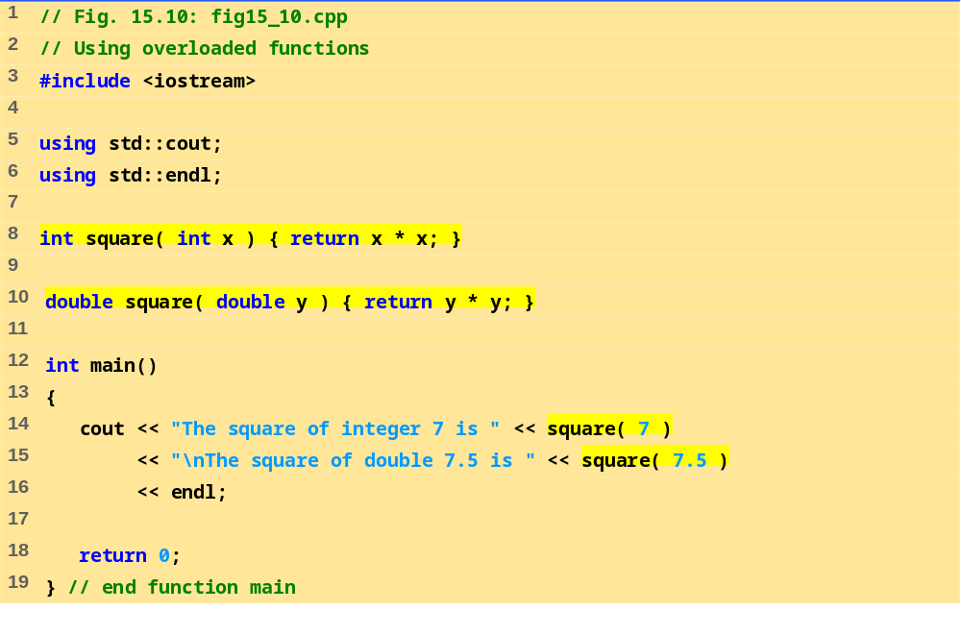
fig15_10.cpp
The square of integer 7 is 49
The square of double 7.5 is 56.25

Slide 33
15.11 Function Templates
Function templates
  Compact way to make overloaded functions
  Keyword template
  Keyword class or typename before every formal type parameter (built in or user defined)
  template < class T > //or template< typename T >
  T square( T value1)
  {
  return value1 * value1;
  }
  T replaced by type parameter in function call
      int x;
      int y = square(x);
      If int parameter, all T's become ints
      Can use float, double, long...

Slide 34
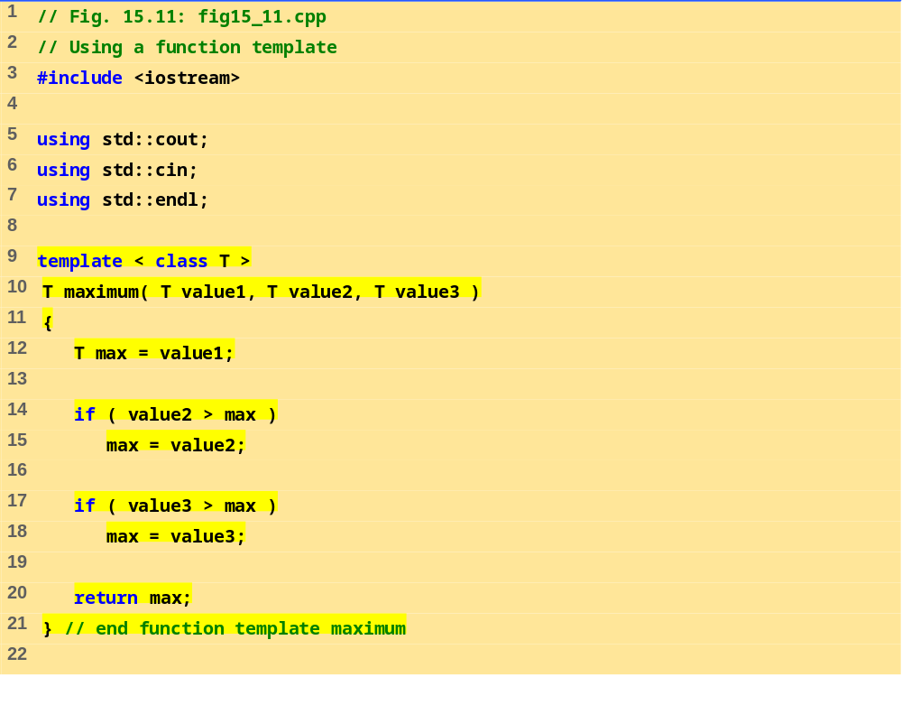
fig15_11.cpp (Part 1 of 2)

Slide 35
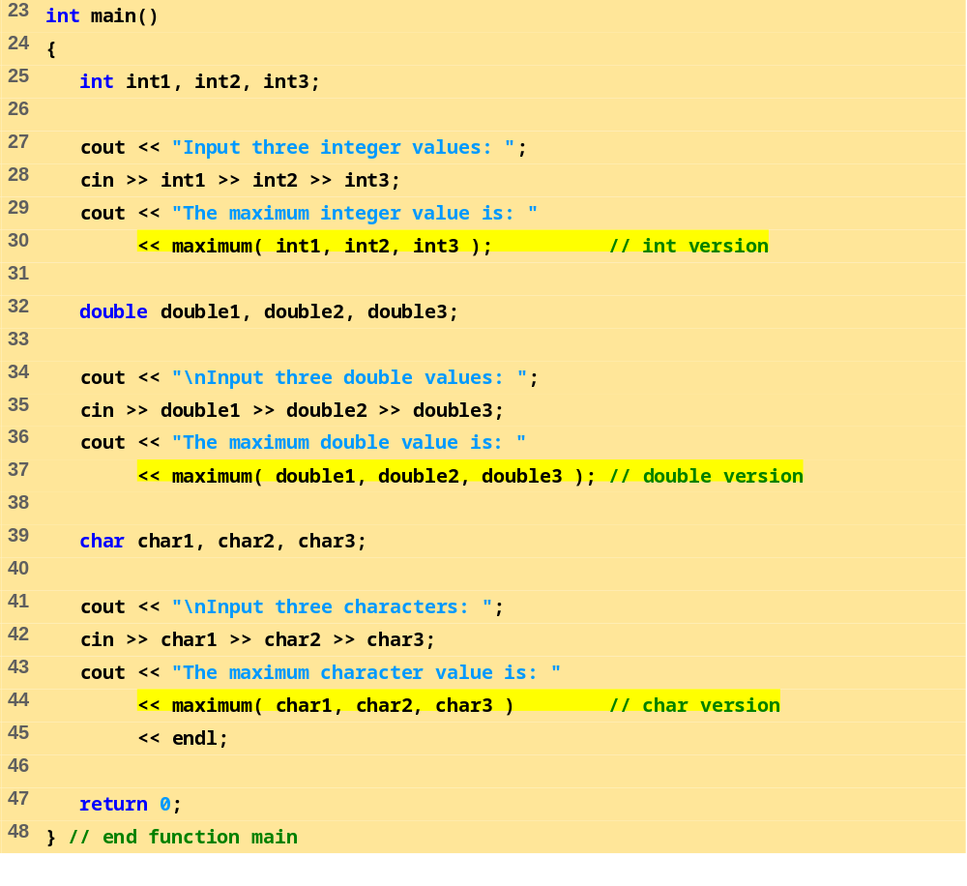
fig15_11.cpp (Part 2 of 2)

Slide 36
Program Output
Input three integer values: 1 2 3
The maximum integer value is: 3
Input three double values: 3.3 2.2 1.1
The maximum double value is: 3.3
Input three characters: A C B
The maximum character value is: C

